Slide 1
Dispatches from the Front:
The Colorado Clean Air-Clean Jobs Act
Platts 5th Annual Rockies
Gas and Oil Conference
Ron Binz
Public Policy Consulting
April 14, 2011

Slide 2
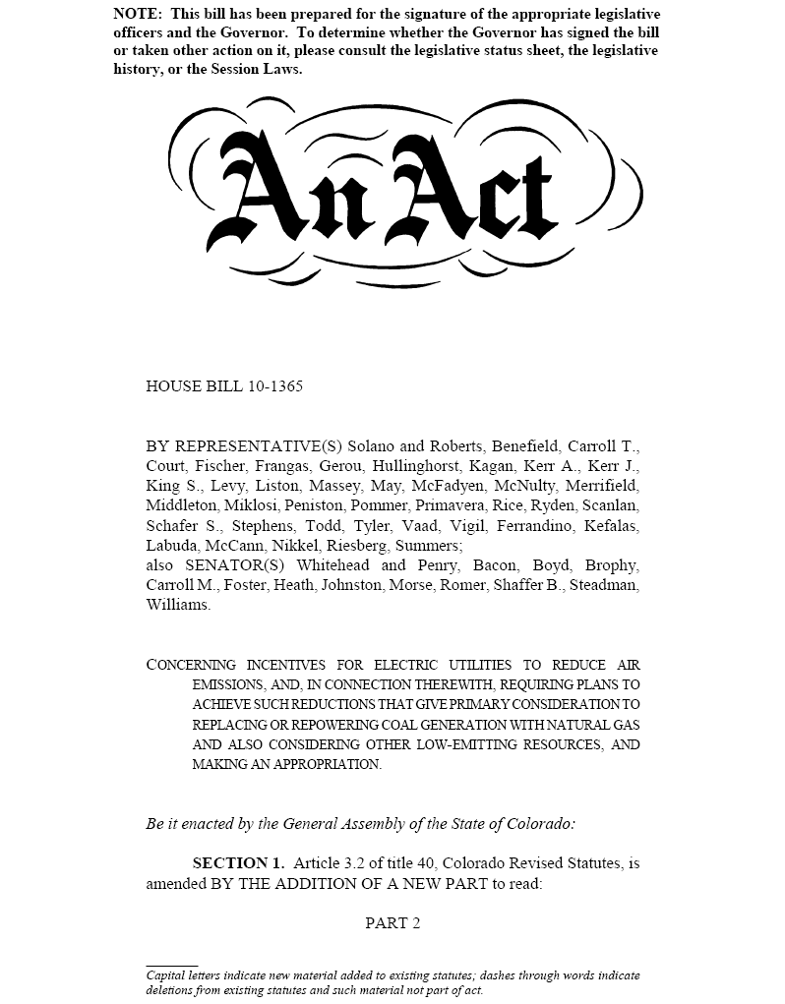

Slide 3
Summarized History for Bill Number HB10-1365
03/15/2010 Introduced In House - Assigned to Transportation & Energy + Appropriations
03/16/2010 House Committee on Transportation & Energy Refer Amended to Appropriations
03/19/2010 House Committee on Appropriations Refer Amended to House Committee of the Whole
03/19/2010 House Second Reading Special Order - Passed with Amendments
03/22/2010 House Third Reading Passed
03/23/2010 Introduced In Senate - Assigned to Agriculture and Natural Resources + Appropriations
03/25/2010 Senate Committee on Agriculture and Natural Resources Refer Amended to Appropriations
03/26/2010 Senate Committee on Appropriations Refer Unamended to Senate Committee of the Whole
03/29/2010 Senate Second Reading Special Order - Laid Over Daily
03/30/2010 Senate Second Reading Passed with Amendments
03/31/2010 House Considered Senate Amendments - Result was to Concur - Repass
03/31/2010 Senate Third Reading Passed
04/08/2010 Signed by the President of the Senate
04/08/2010 Signed by the Speaker of the House
04/09/2010 Sent to the Governor
04/19/2010 Governor Action - Signed
8
9

Slide 4
Structure of HB10-1365
Utility must consult with state air regulator (CDPHE) on a plan to meet current and reasonably foreseeable EPA clean air rules.
Utility files plan with PUC to improve air quality, addressing at least half of coal generation up to 900 MW.
Utility required to conduct various studies:
  Plan impacts on NO_{x} emissions (must reduce by 70%-80%)
  Cost of controlling emissions at existing coal plants
  Cost of replacing 900 MW coal generation with natural gas
  Impacts on system reliability
CDPHE will participate in PUC process.
Any PUC-approved plan must meet projected EPA rules.
Air Quality Control Commission will incorporate approved plan into State Implementation Plan (SIP) for addressing regional haze.
New law specifies some details of regulatory cost recovery

Slide 5
HB10-1365 PUC Timeline for Xcel
April 19 |  | Bill signed into law
April 21 |  | PUC opened docket
May 27 |  | Prehearing conference
 |  | Ruling on Interventions (34 parties)
August 15 |  | Xcel filed preferred and alternate plans
November |  | Hearings (~90 witness testimonies)
December 15 |  | PUC Order
January 2011 |  | CDPHE adopts SIP
April 2011 |  | Legislature considers SIP

Slide 6

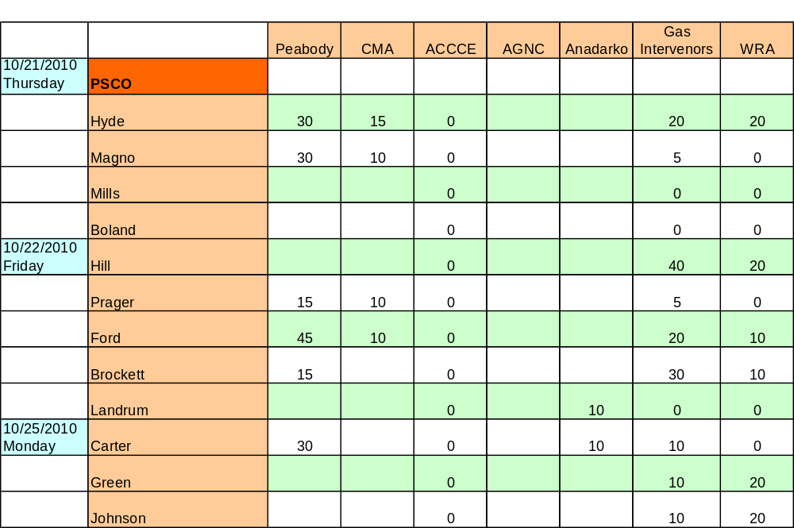

Slide 7
Highlights of the Proceeding
Utility plan addressed 1801 MW
Utility filed analysis of ~20 plans (7 basic plans with variations)
Interventions by large gas and coal interests
Two very large public hearings
Prefiled testimony of 61 expert witnesses; 30 more rebuttal
Utility rejected “controls-only” plan
Utility’s preferred plan was ruled not in compliance with new statute; utility filed new plans and identified new preferred plan
CDPHE rejected some plans as insufficient to meet EPA rules
Long-term natural gas contract approved
Motions filed to disqualify two commissioners
Hearings in evenings and on Saturdays

Slide 8
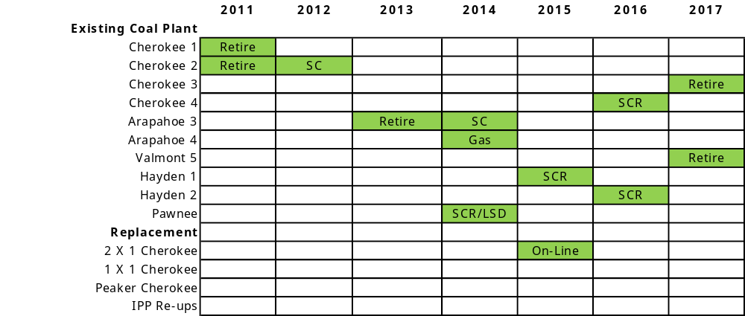

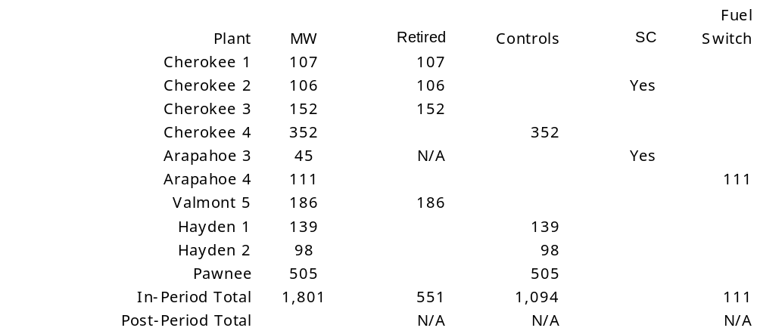
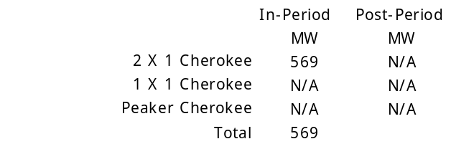

Scenario 5B
SC = Synchronous Condensor SCR = Selective Catalytic Reduction Control
Gas = Fuel Switch from Coal to Gas LSD = Lime Spray Dryer
Retirement and Controls
Replacement Capacity
IPP Re-ups
PSCo Electric 10M-245E
Scenario Analysis
8

Slide 9
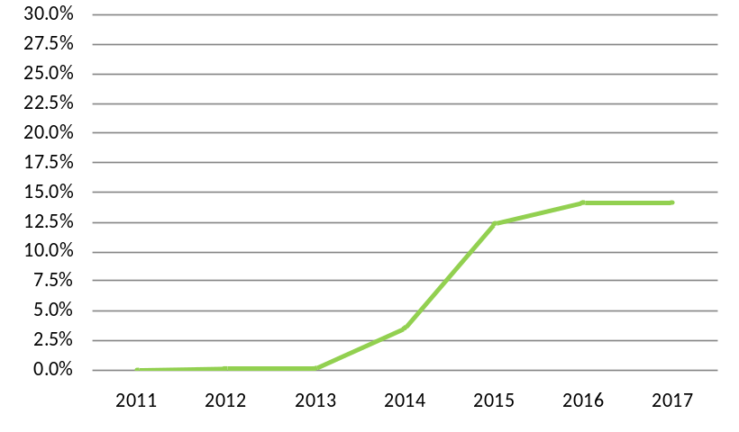
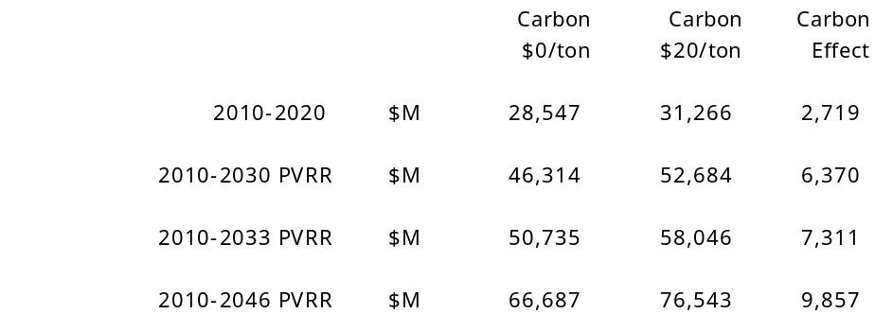
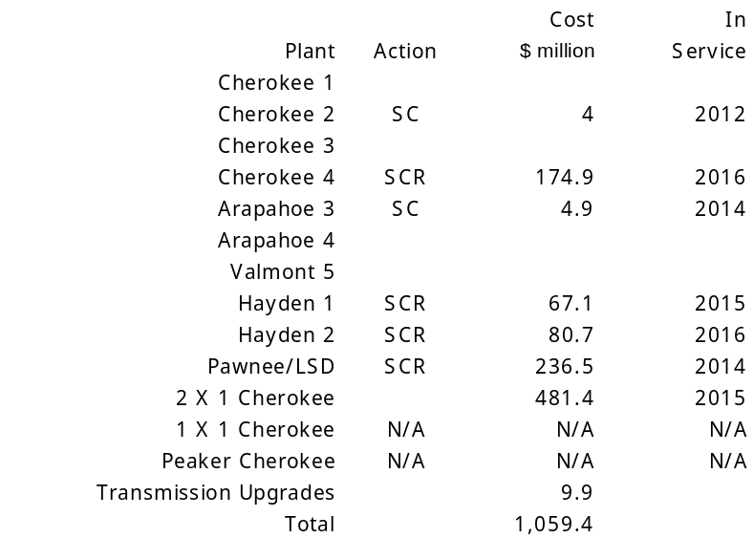
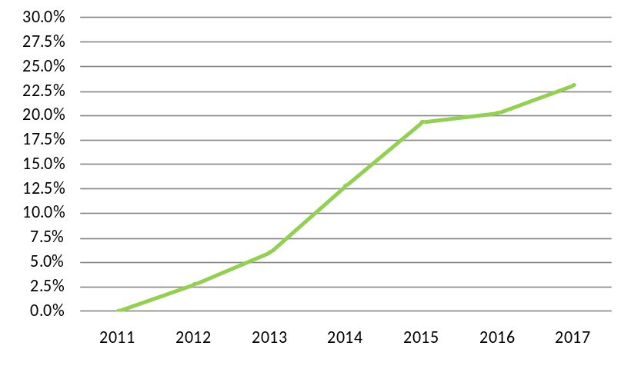
Scenario 5B
Estimated Near Term Base Rate Effects
STRATEGIST Revenue Requirements
Estimated Percentage Increase in Base Rates
Capital Investments
STRATEGIST Rates Analysis ($0/ton carbon)
Estimated Percentage Increase in Total Rates

Slide 10
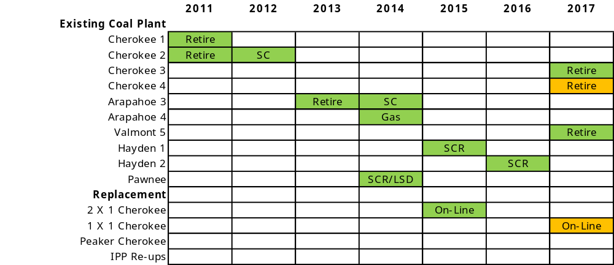

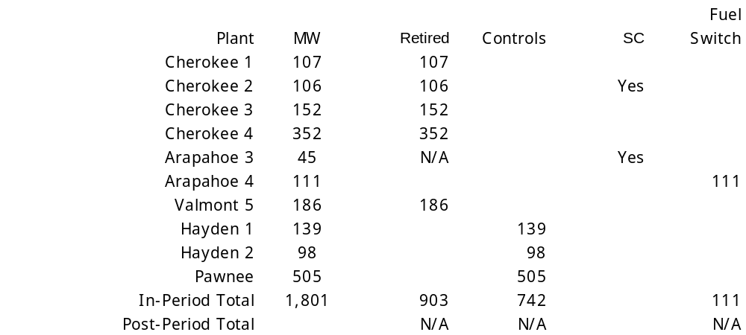
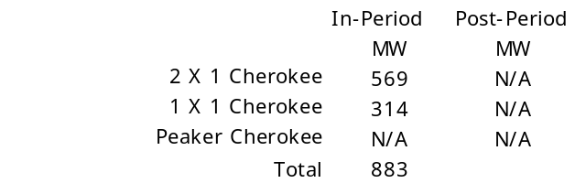

Scenario 6.2J
SC = Synchronous Condensor SCR = Selective Catalytic Reduction Control
Gas = Fuel Switch from Coal to Gas LSD = Lime Spray Dryer
Retirement and Controls
Replacement Capacity
IPP Re-ups

Slide 11
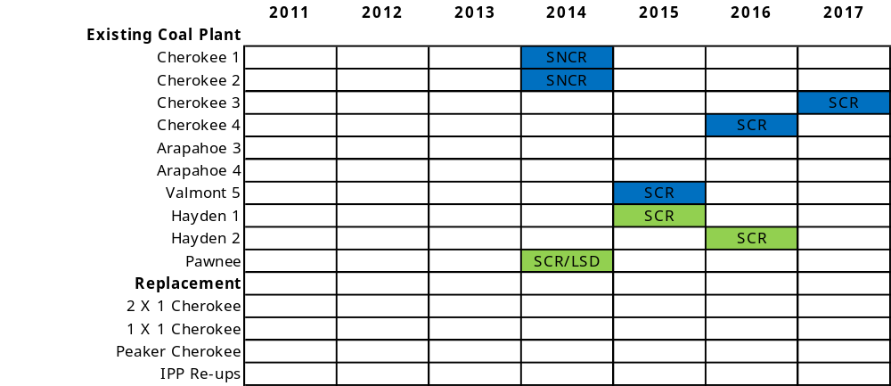

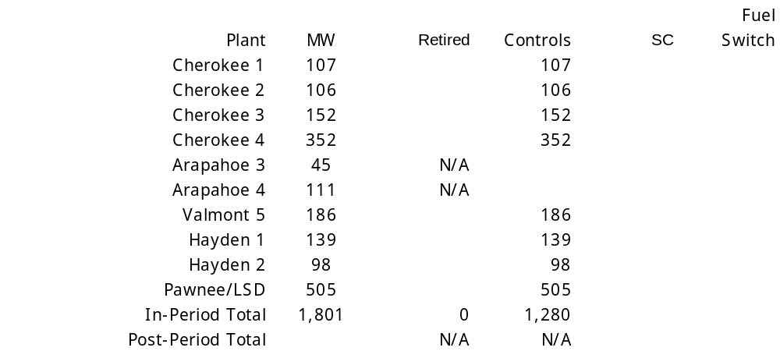
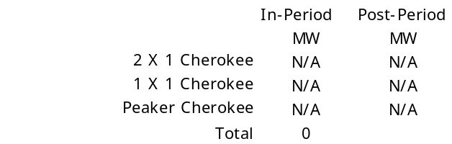

Benchmark 1.0
SC = Synchronous Condensor SCR = Selective Catalytic Reduction Control
Gas = Fuel Switch from Coal to Gas LSD = Lime Spray Dryer
Retirement and Controls
Replacement Capacity
IPP Re-ups

Slide 12
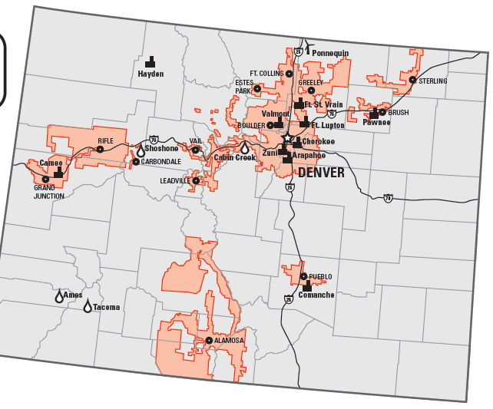
Decisions on PSCo Plants
Unit | Size | Action | Date
Cherokee 1 | 107 MW | Retirement | 2011
Cherokee 2 | 106 MW | Retirement | 2011
Cherokee 3 | 152 MW | Retirement | 2015
Cherokee 4 | 352 MW | Conversion | 2017
Arapahoe 3 | 45 MW | Retirement | 2013
Arapahoe 4 | 111 MW | Conversion | 2014
Valmont 5 | 186 MW | Retirement | 2017
Hayden 1 | 139 MW | Controls | 2015
Hayden 2 | 98 MW | Controls | 2016
Pawnee | 505 MW | Controls | 2014
Source: Xcel Energy – Summary Report for Investors 2009

Slide 13
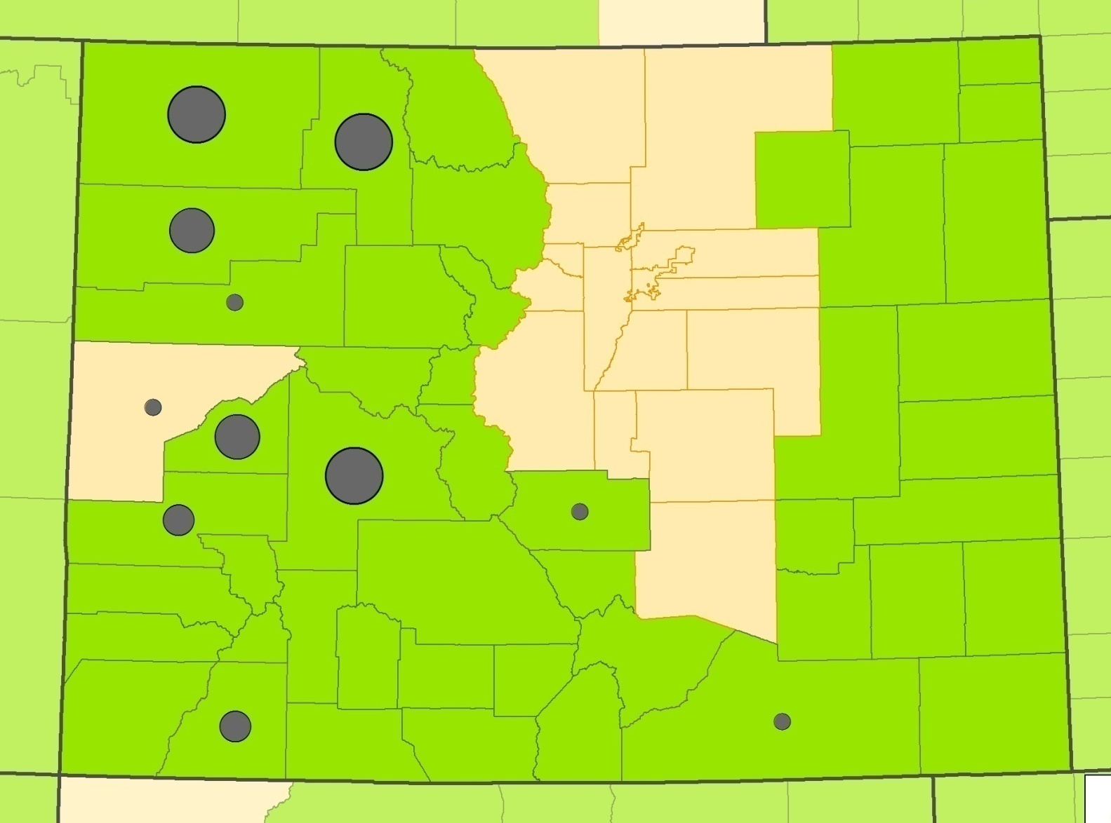

Colorado Coal Mining
Source: http://wvrhrc.hsc.wvu.edu/images/coal_mining_atlas_1994-2005_colorado.jpg

Slide 14
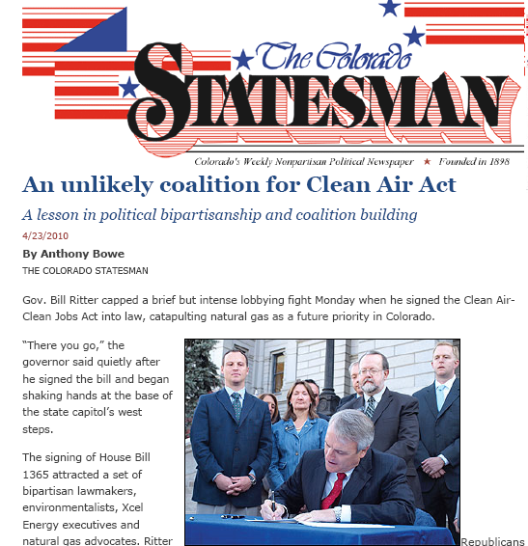
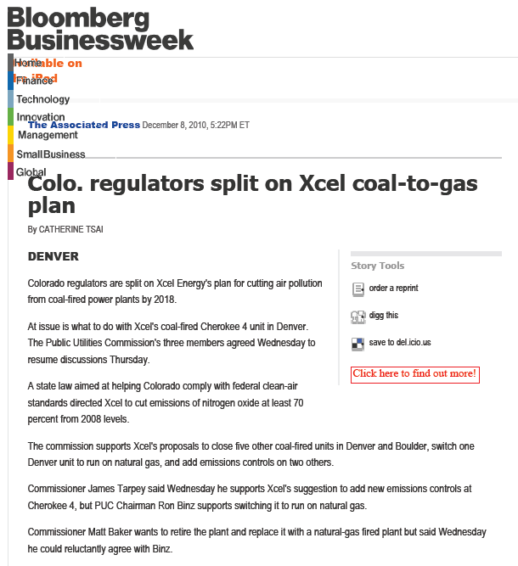
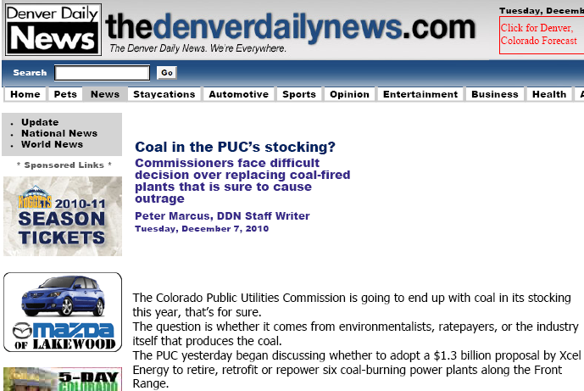
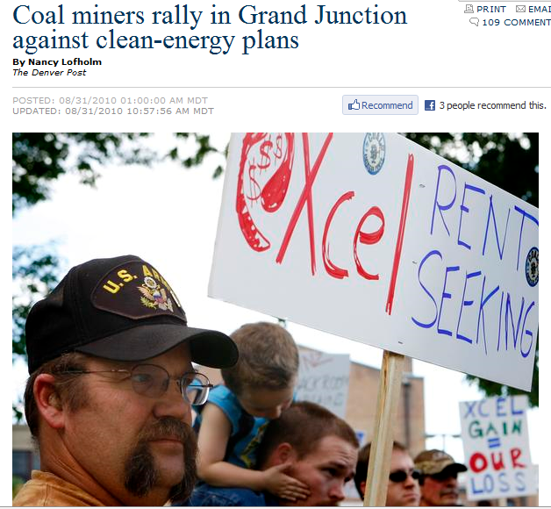
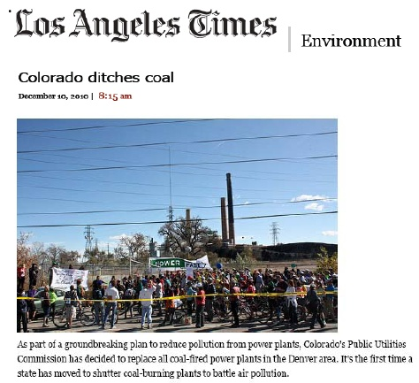

Slide 15
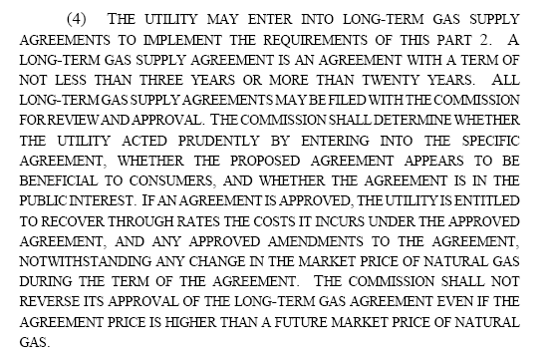
Long Term Natural Gas Contracts
(4) THE UTILITY MAY ENTER INTO LONG-TERM GAS SUPPLY
AGREEMENTS TO IMPLEMENT THE REQUIREMENTS OF THIS PART 2. A
LONG-TERM GAS SUPPLY AGREEMENT IS AN AGREEMENT WITH A TERM OF
NOT LESS THAN THREE YEARS OR MORE THAN TWENTY YEARS. ALL
LONG-TERM GAS SUPPLY AGREEMENTS MAY BE FILED WITH THE COMMISSION
FOR REVIEW AND APPROVAL. THE COMMISSION SHALL DETERMINE WHETHER
THE UTILITY ACTED PRUDENTLY BY ENTERING INTO THE SPECIFIC
AGREEMENT, WHETHER THE PROPOSED AGREEMENT APPEARS TO BE
BENEFICIAL TO CONSUMERS, AND WHETHER THE AGREEMENT IS IN THE
PUBLIC INTEREST. IF AN AGREEMENT IS APPROVED, THE UTILITY IS ENTITLED
TO RECOVER THROUGH RATES THE COSTS IT INCURS UNDER THE APPROVED
AGREEMENT, AND ANY APPROVED AMENDMENTS TO THE AGREEMENT,
NOTWITHSTANDING ANY CHANGE IN THE MARKET PRICE OF NATURAL GAS
DURING THE TERM OF THE AGREEMENT. THE COMMISSION SHALL NOT
REVERSE ITS APPROVAL OF THE LONG-TERM GAS AGREEMENT EVEN IF THE
AGREEMENT PRICE IS HIGHER THAN A FUTURE MARKET PRICE OF NATURAL
GAS.

Slide 16
Gas Prices: Market Forecast vs.
Anadarko Long Term Contract Forecast
Notes:
Market forecast used latest market info (NYMEX futures) and long term forecasts from Wood Mackenzie, Cambridge Energy Research Assoc (CERA), and Petroleum Industry Research Associates (PIRA) forecasts for Henry Hub. (Just NYMEX through June 2013, then weighted blend w/4 source forecast through 2015, then only the 4 source forecast.)

Slide 17
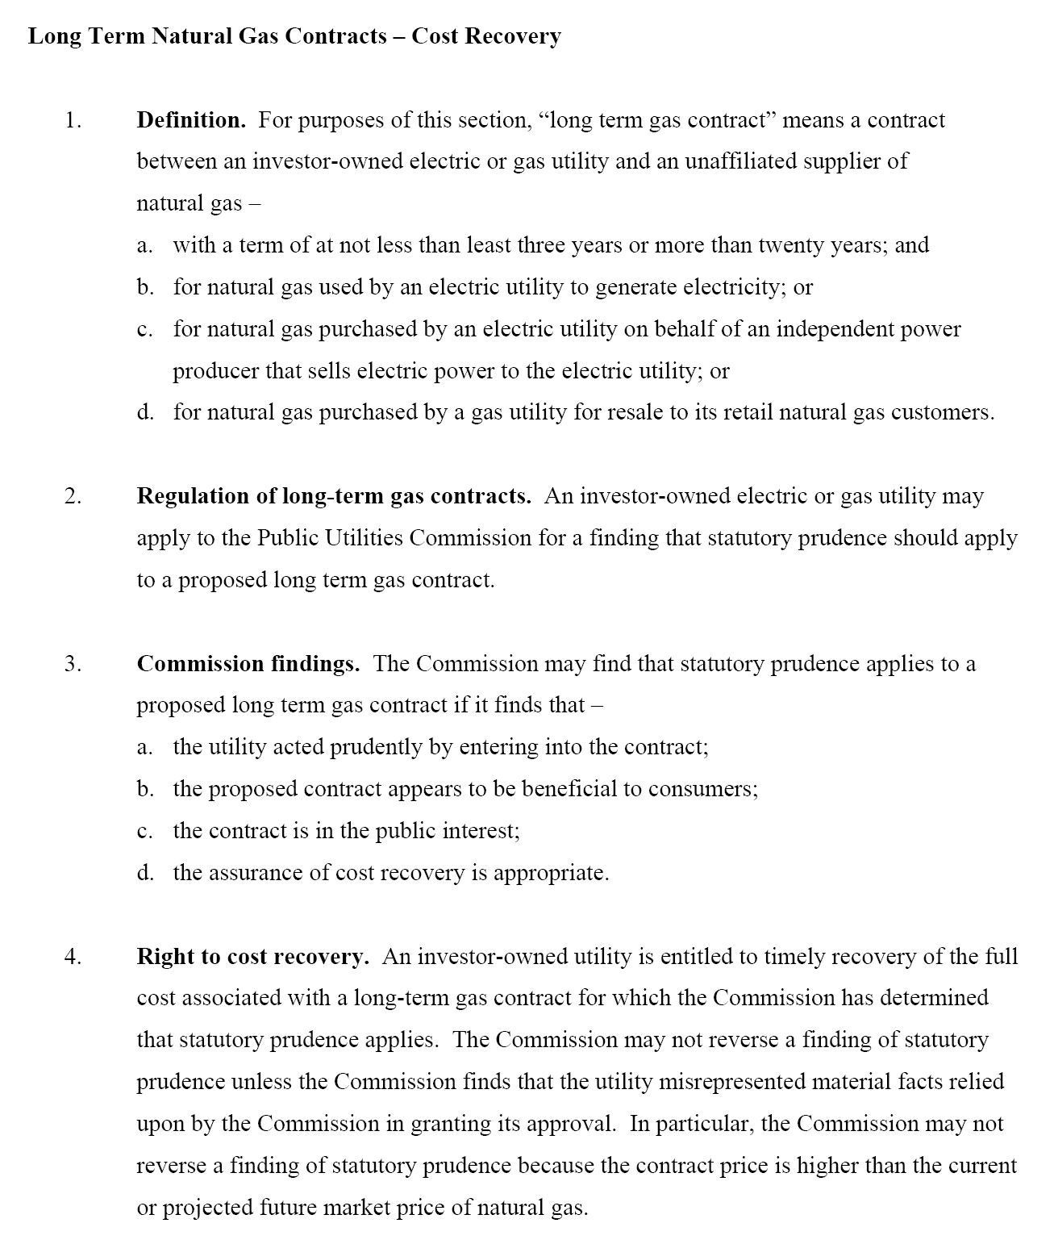
Model Legislation
Available at:
www.rbinz.com/LTContracts.pdf

Slide 18
Thanks for the invitation.
I look forward to your questions.
Ron Binz, Principal
Public Policy Consulting
www.rbinz.com
720-425-3335
rbinz@rbinz.com

