Slide 1
Technology Provides
New Transmission Options
NARUC – NCSL
Transmission Policy Institute Workshop
Ron Binz
Public Policy Consulting
April 20, 2011

Slide 2
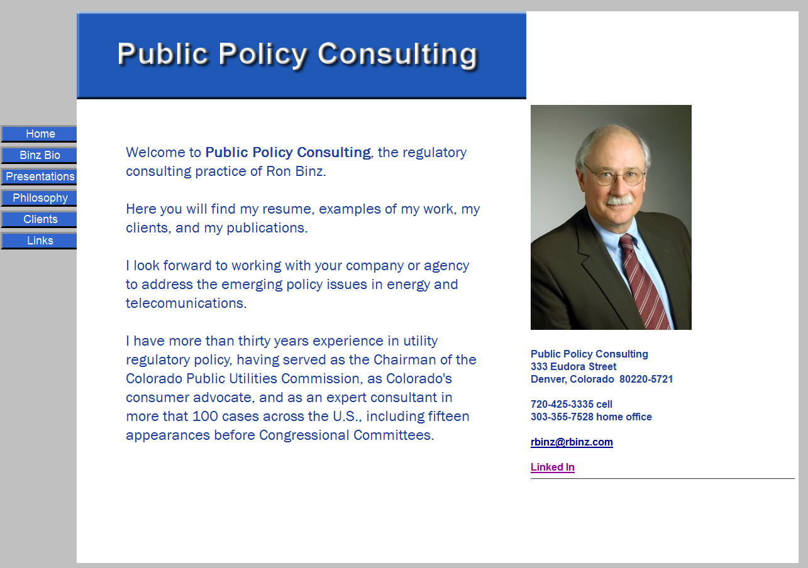
Public Policy Consulting
Expertise in energy and telecom
  advocacy
  staff training
  counsel, advising
  expert testimony
Focus areas:
  climate
  clean tech/green tech
  improving regulation
  enabling competition
www.rbinz.com

Slide 3
Topics for this presentation
Transmission innovation
How regulators see transmission
Transmission and consumer costs
Innovation and regulation generally
Practical advice for policy makers

Slide 4


Slide 5
Examples of Transmission Innovation
New materials
New technologies
New methods
New control systems
New pricing
New materials
  composite conductors
New technologies
  superconductivity
New methods
  Dr. Edris’ presentation
New control systems
  synchrophasors
New pricing
  congestion pricing

Slide 6
Transmission and Smart Grid
Smart Grid: applying IT to electricity delivery and use.
Tendril calls it the Energy Internet
Not just about smart meters
Much will be “behind-the-scenes”

Slide 7
How utility regulators see transmission
Critical for most energy goals
More of problem than a resource
Incredibly difficult to accomplish
Hard to understand and explain
Second-order element of utility costs
Politically volatile

Slide 8
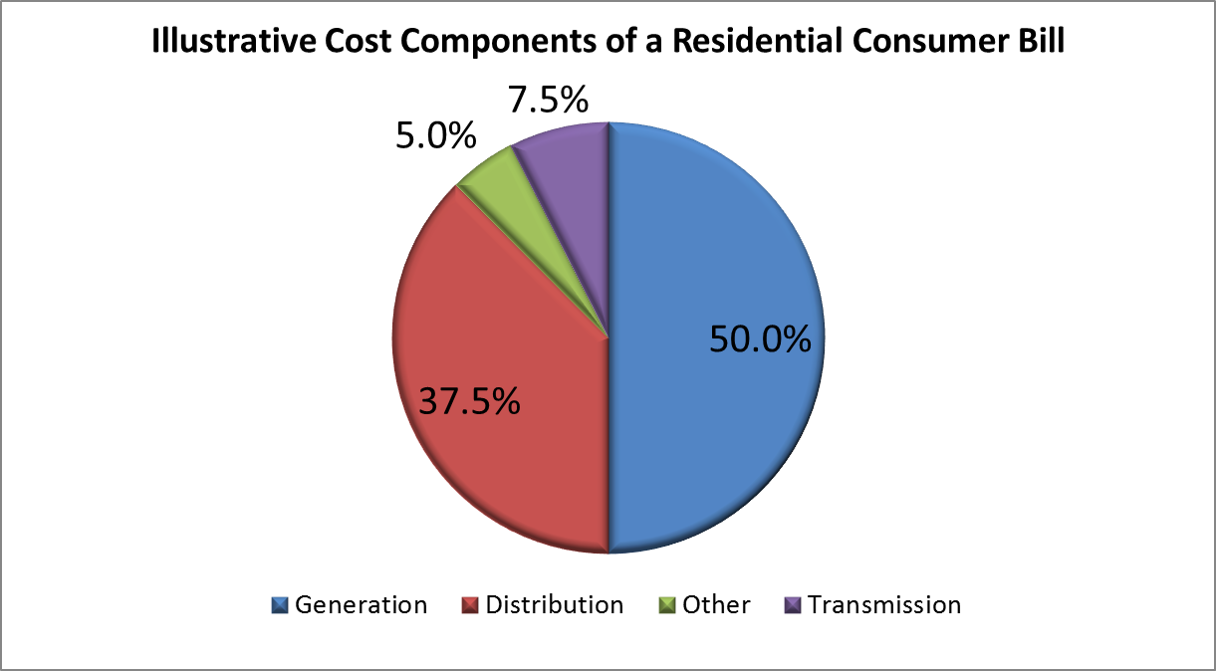
Transmission and Consumer Bills

Slide 9
Innovation and Regulation
The “Regulators’ Motto”
Risk/reward function for utilities and regulators skewed against innovation
Technological innovation difficult but necessary
Opportunities
  Pilot demonstration projects
  Participation in EPRI
  Innovative regulation

Slide 10
Regulators Need Help
Legislators should clarify regulator’s role
Legislators should articulate outcomes, not specify tactics
Legislators should permit flexible budgeting and staffing for PUCs
Legislators should engage regulators at beginning of a bill process

Slide 11
Thanks for the invitation.
I look forward to your questions.
Ron Binz, Principal
Public Policy Consulting
www.rbinz.com
720-425-3335
www.rbinz.com
rbinz@rbinz.com

